Slide 1




StayZen
Keeping Customers, Reducing Churn
A data-driven approach to understanding and reducing customer churn
Supervised by: Eng Mahmoud Emad

Slide 2




Our Team:
StayZen
Engi Eid
Hager Elmalah
Mazen Tarek
Nada Alaa

Slide 3

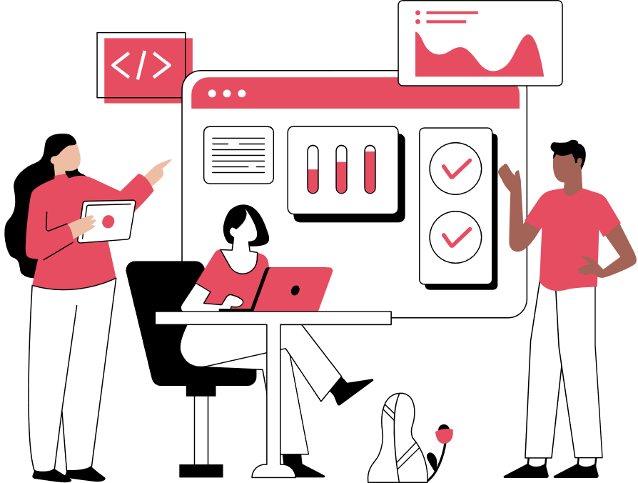

Business Overview
The telecom industry is highly competitive, with customers having multiple alternatives.
Customer retention is more cost-effective than acquiring new customers.
Managing churn is essential to maintain stable revenue and improve long-term profitability.
Our project focuses on understanding customer behavior and identifying factors leading to churn.

Slide 4

Business Problem
The company is experiencing a rising customer churn rate.
Losing customers directly impacts revenue and market share.
Key business question:
“Which customers are most likely to churn, and why?”
Understanding churn drivers helps target customers with personalized retention strategies.

Slide 5


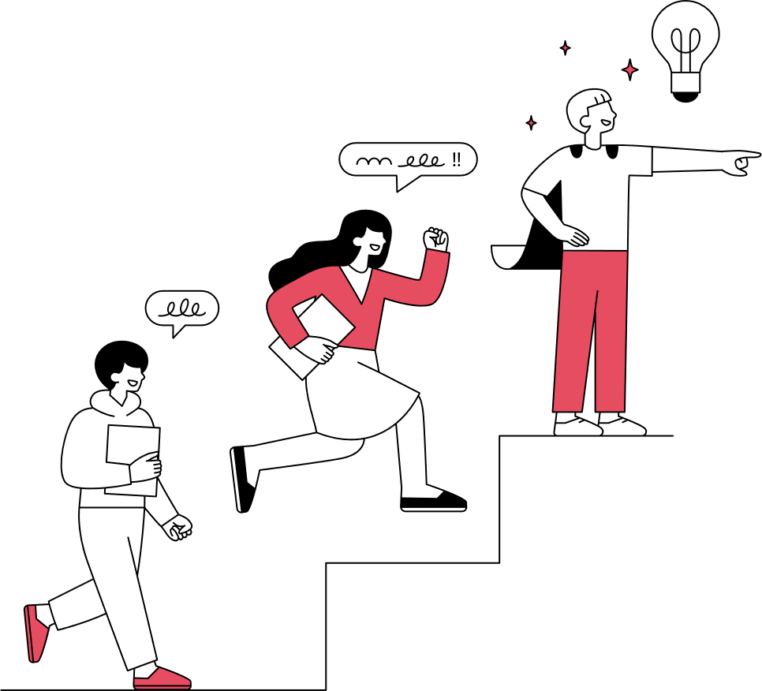



Conduct in-depth Exploratory Data Analysis (EDA) to understand customer behavior.
Our Solution
Create an interactive dashboard for business teams to monitor churn.
Build a predictive model to identify customers at high risk of churn.
Develop a Streamlit app to provide real-time churn predictions.
Translate findings into clear business recommendations.

Slide 6


Let’s review the dataset to understand the key features

Slide 7


Dataset Overview
Total customers: 440,832
Total Features: 12
Account & Contract Details
Service Usage Behavior
Customer Information
CustomerID
Subscription Type
Contract Length
Tenure
Gender
Age
Usage Frequency
Last Interaction
Billing & Payment
Customer Support Interaction
Target Variable
Total Spend
Payment Delay
Support Calls
Churn (Yes/No)

Slide 8
Next, let’s take a look at our findings.

Slide 9
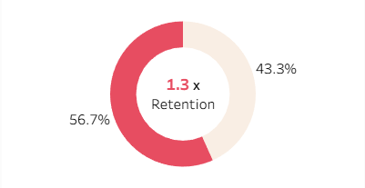
Our data shows a churn rate of 56.7%, which is exceptionally high and indicates a significant risk of losing more than half of our customer base.

Slide 10
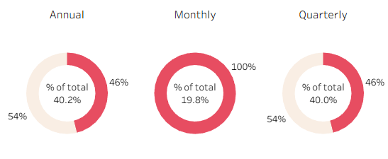
Contract Length
Our data shows that nearly all customers on a monthly contract type churned, while those on quarterly or annual contracts churned at a 46% rate

Slide 11
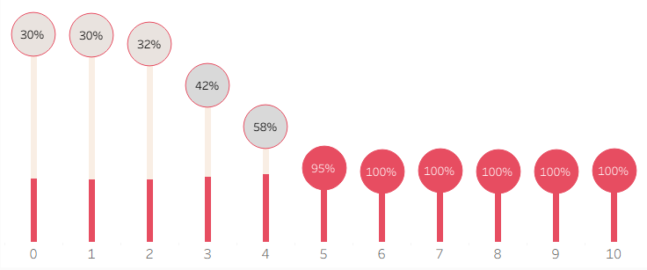
Support Calls
➡ All customers who recorded more than five support calls ended up churning, with no exceptions — highlighting a critical dissatisfaction pattern among high-contact users

Slide 12
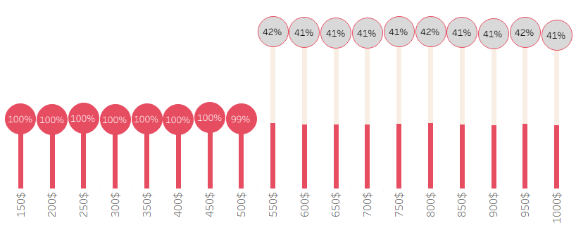
Total Spend
➡ Revenue Churn rate : 48.6%
➡ All customers whose total spend was below $500 ended up churning, which suggests that low-value customers were far more likely to discontinue the service

Slide 13
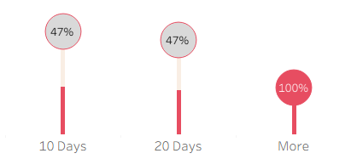
Payment delay
➡ Every customer who delayed payment by more than 20 days ended up churning
➡ a clear indication that late payment is strongly associated with customer attrition.

Slide 14
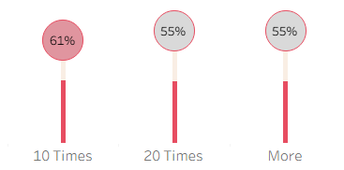
Usage Frequency
➡ Customers who used the service fewer than ten times in the last month showed a higher likelihood of churning.

Slide 15
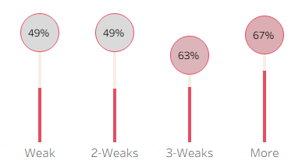
Last Interaction
➡ Customers whose last interaction with our service was three weeks ago or more showed a higher churn rate compared to those who engaged with us more recently.

Slide 16
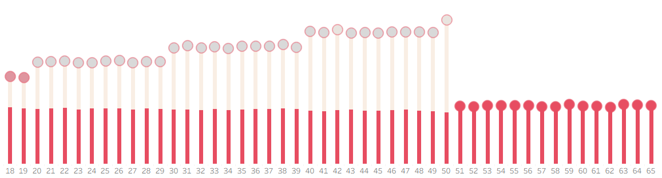
Age
➡ all customers over 50 years old churned, customers aged 40–50 had a lower churn rate, while churn was somewhat high among customers aged between 18 and 20.”

Slide 17
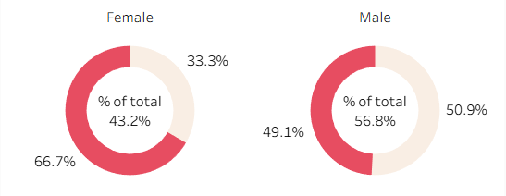
Gender
Two-third of female customers churned, while less than half of male customers did. Overall, the proportion of male participants in our dataset is higher than that of females.

Slide 18
Next, let’s take a look at our Dashboard.

Slide 19
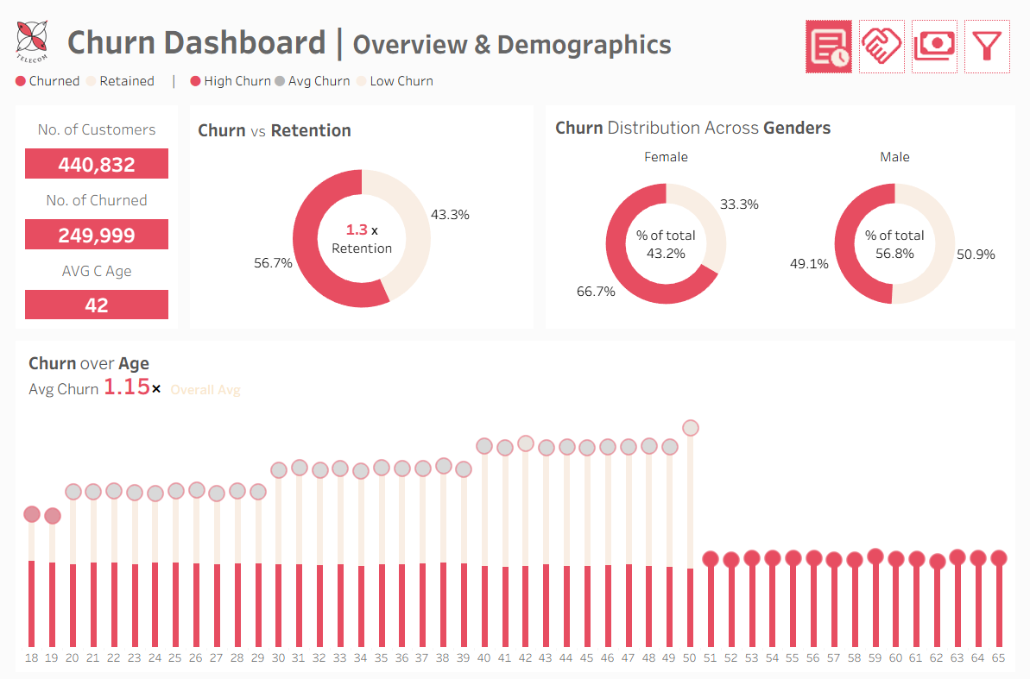

Slide 20
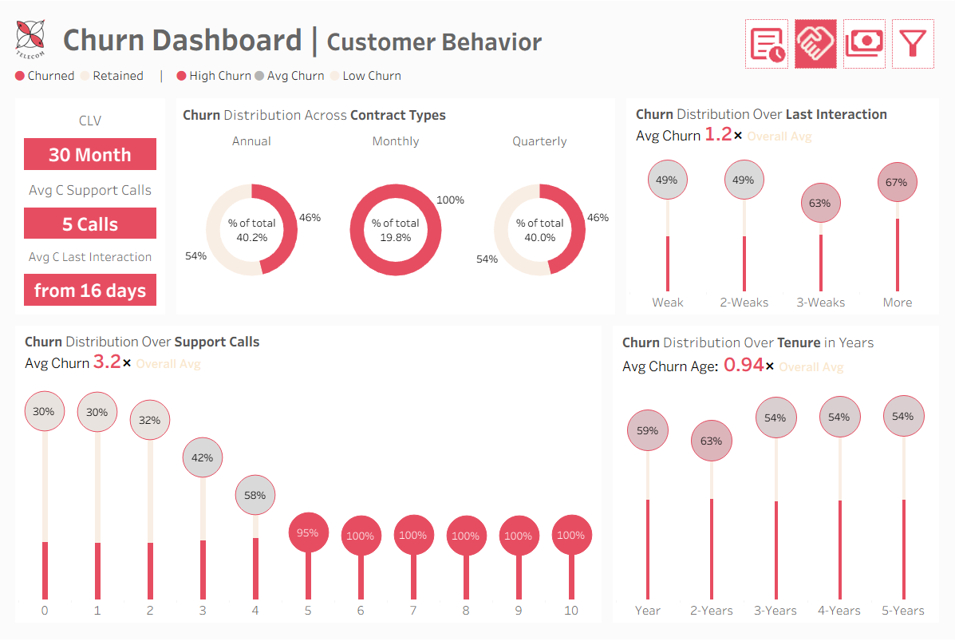

Slide 21
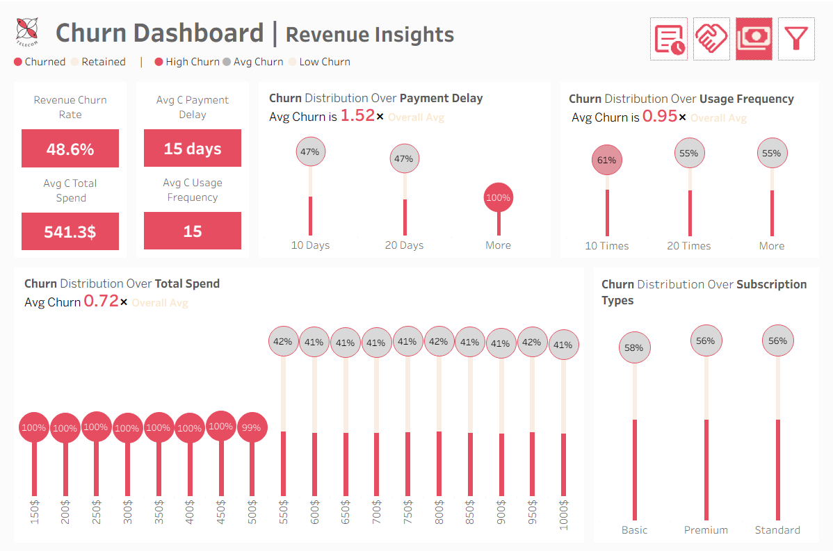

Slide 22
Next, let’s take a look at our predictive model.

Slide 23


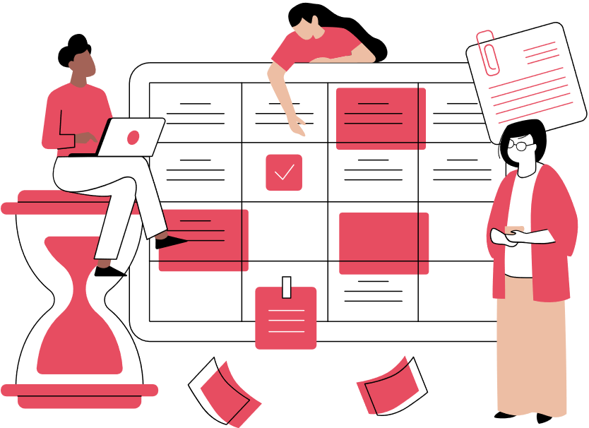
Predictive Models for Customer Churn
Enable targeted retention strategies
Support decision-making for promotions, loyalty programs, and customer support improvements
Two machine learning models were built to predict customer churn:
Random Forest
XGBoost
Accuracy = 0.99
Recall = 0.99
Precision = 0.99
Accuracy = 0.97
Recall = 0.99
Precision = 0.95

Slide 24
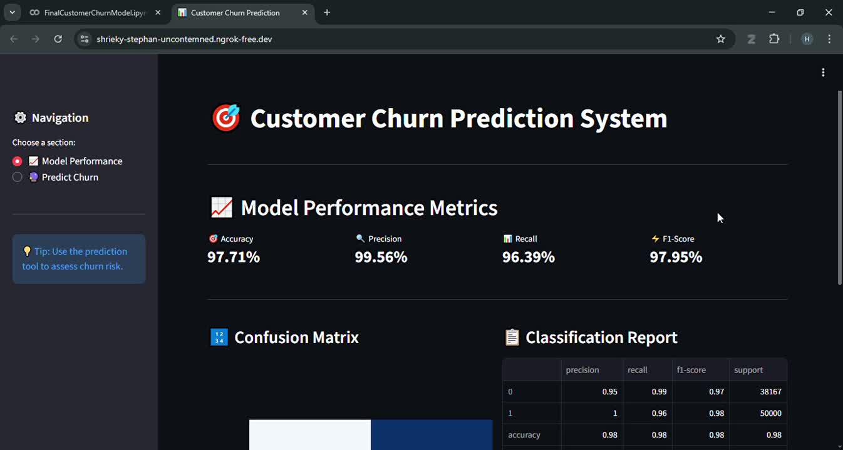
Streamlit App Demo

Slide 25
Next, let’s take a look at our recommendations.

Slide 26

Business Recommendations
Improve retention campaigns for customers with high monthly charges.
Enhance customer support for those with multiple service complaints.
Introduce loyalty programs for long-term customers.
Offer discounts or flexible contracts to high-risk segments.
Continuous monitoring using dashboards and predictive models.

Slide 27


THANK YOU

